Slide 1
LifeMap: A Smartphone-Based Context Provider for Location-Based Services
(By Yohan Chon and Hojung Cha, IEEE Pervasive Computing, April-June 2011)
Myungchul Kim
mck@kaist.ac.kr

Slide 2
Introduction
LifeMap, a smartphone-based context provider operating in real time, fuses accelerometer, digital compass, Wi-Fi, and GPS to track and automatically identify points of interest with room-level accuracy.
Scenarios
  a company scouting for locations to display its advertisements can obtain useful information on various places frequented by urban women in their twenties in the evening.
  Parents could acquire information on where their children usually go at certain times of the day.
  The Board of Health Ministry could trace the routes taken by people infected with specific diseases.

Slide 3
Introduction
Location information forms a core context in a pervasive computing environment.
  GPS
  a GPS signal is available only 4.5 percent of the time during a typical user’s day.
  The Wi-Fi positioning system for indoor environments
  the prevailing technology used for indoor locating systems hardly satisfies the need for a cost-effective solution, nor does it provide the required room-level locating accuracy.
LifeMap uses inertial sensors in the smartphone to provide indoor location information. The information is combined with GPS and Wi-Fi positioning systems to generate user context in daily life.

Slide 4
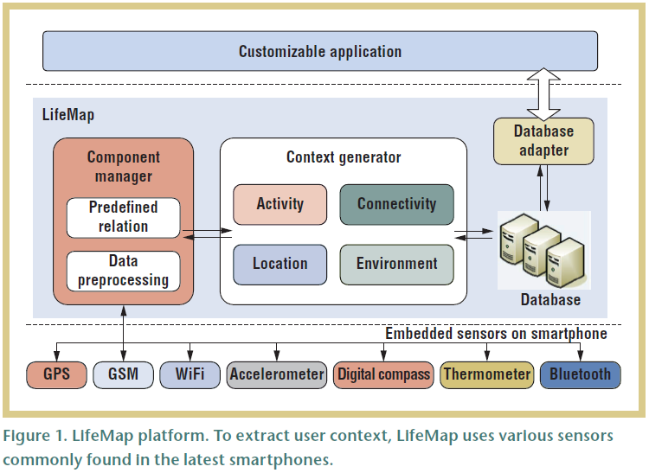
LifeMap Platform
Fig1

Slide 5
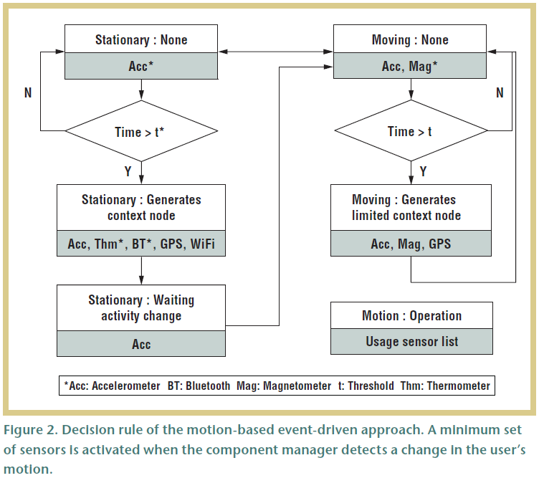
LifeMap Platform
Accelerometers
  relatively low power consumption
  user motion such as moving and stationary
Fig 2

Slide 6
Context Generator
generates a categorized user context into four parts
  Location represents the user’s position on Earth. Location information is specified with properties of the scanned Wi-Fi access point to determine room-level identification.
  Activity is defined by two characteristics: user motion and smartphone usage. User motion includes moving in a vehicle, walking, running, or even staying at rest. Smartphone usage includes messaging, calling, taking a picture, and browsing the Web.
  Connectivity shows the current network connection status of the GSM (Global System for Mobile Communications, originally from Groupe Special Mobile) or Wi-Fi.
  Environment is a set of circumstances around the user.

Slide 7
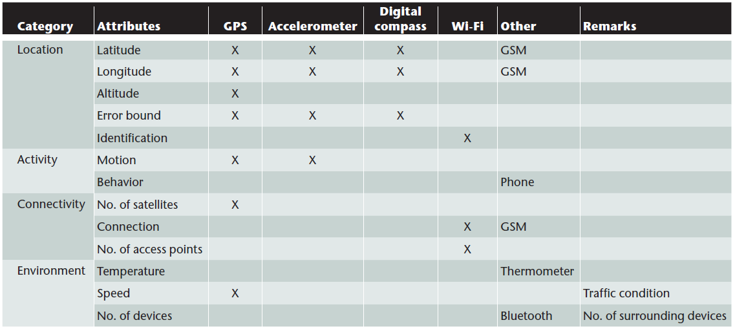
Context Generator
Table 1(Sources of categorized context)

Slide 8
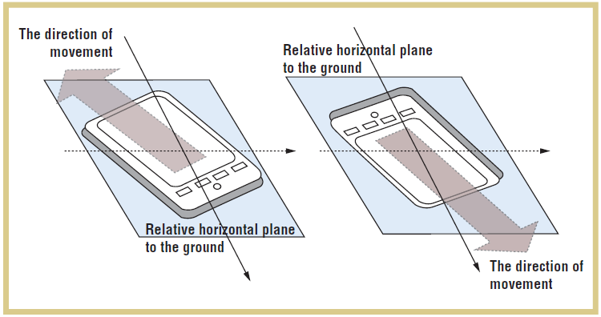
Context Generator
The conventional strapdown system is not applicable to smartphones because fastening the device to the human body is impractical and filtering noise signals
Fig3
A gyroscope could be used to enhance tracking accuracy, but even the latest smartphones do not employ a gyroscope due to its relatively high cost.

Slide 9
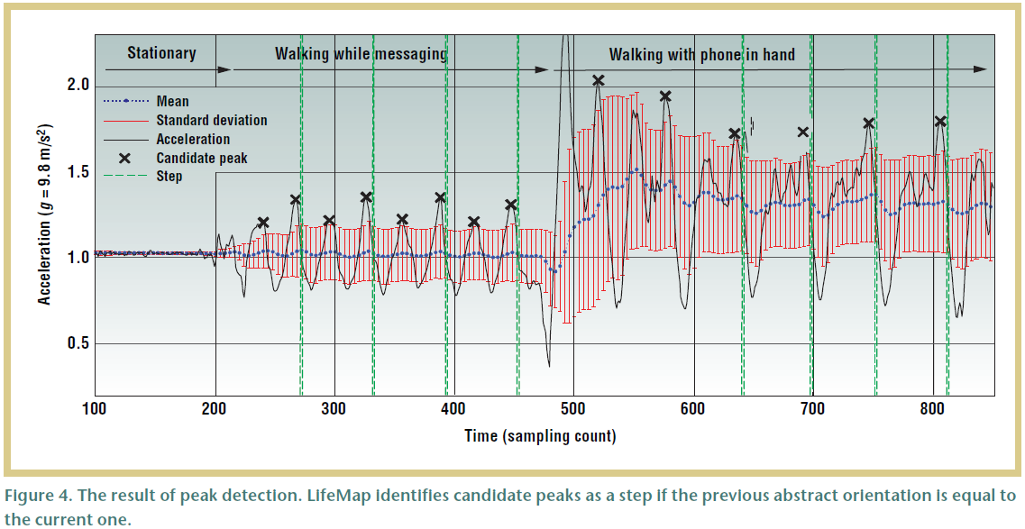
Context Generator
A practical positioning and tracking solution for users in indoor environments relies on both an accelerometer and a digital compass.
Fig4

Slide 10
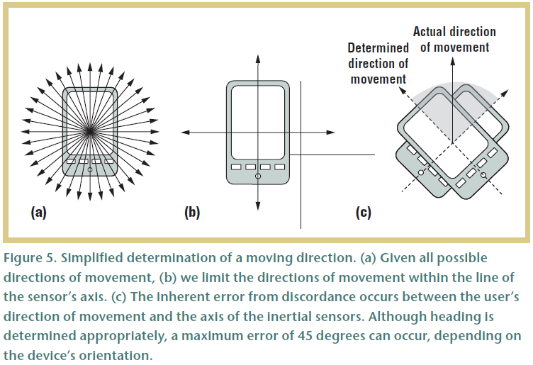
Context Generator
Transforming a local acceleration into a global one is a nontrivial operation for smartphones.
Fig5

Slide 11
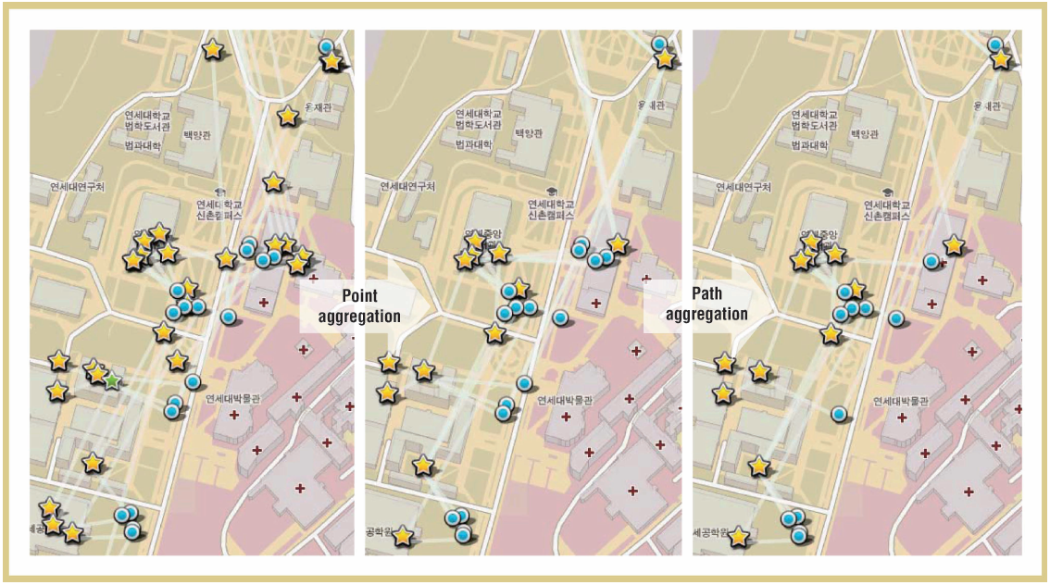
Context Generator
Matching and Aggregation Process
  Location is a key criterion in the matching and aggregation process.
  When two POIs are found to be identical in the matching process, LifeMap aggregates the POIs to refine the context. After aggregating the POIs, the paths are determined for aggregation.
  Fig 6: The stars indicate a stationary state, and the circles indicate a moving state. Here, LifeMap aggregates 34 stationary states and 21 moving states to produce 14 and 12, respectively.

Slide 12
Experiments
LifeMap on the HTC Hero and G1 Android
The LifeMap implementation performs sensing, converts raw data to high-level user context, activates or deactivates required sensors, aggregates user context, and provides user context to end-user applications.
implemented a life-logging application to evaluate and visualize LifeMap on smartphones.

Slide 13
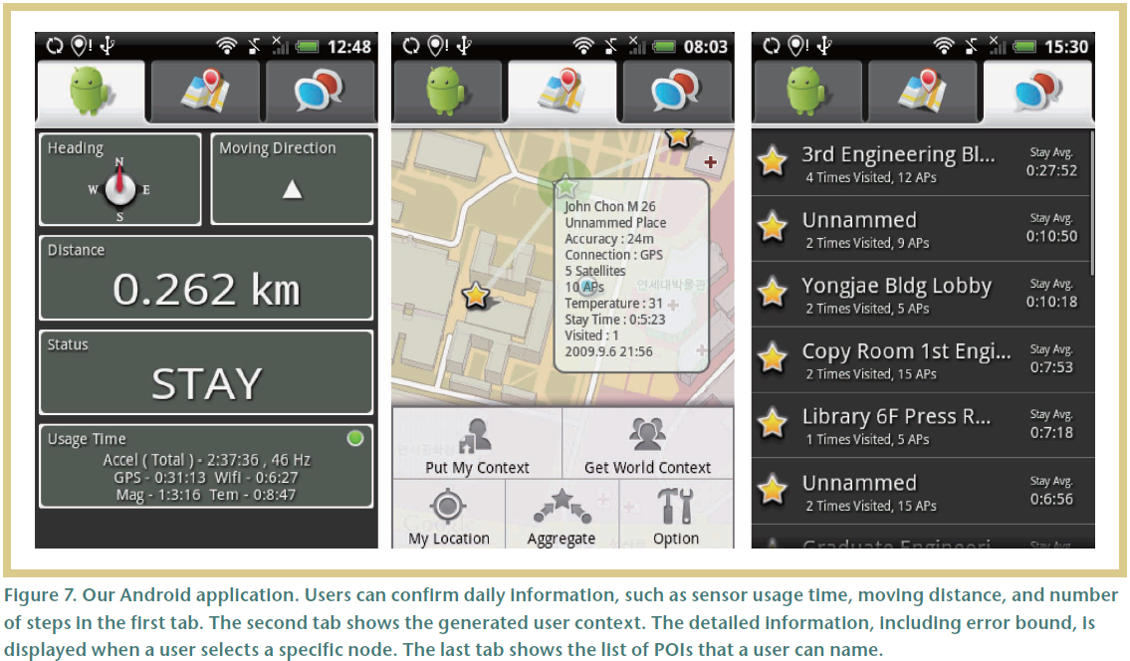
Experiments
Fig 7

Slide 14
Experiments
The major source of location error is distortion of where the user is heading.
  For example, Figure 8 shows that a user’s motion affects his or her heading accuracy. Small user movements such as messaging or calling generate relatively stable results, but the heading becomes unstable if the device is, for example, placed in a pocket while walking.

Slide 15
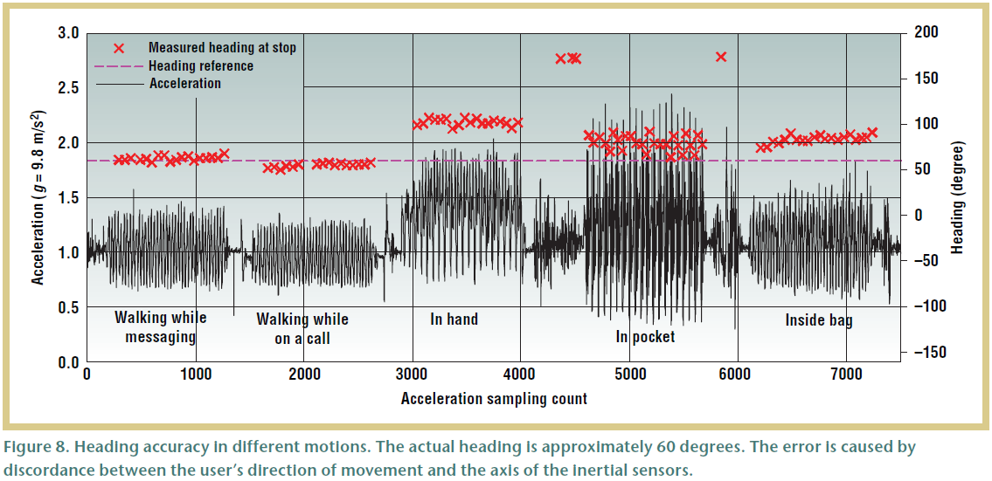
Experiments
Fig 8

Slide 16
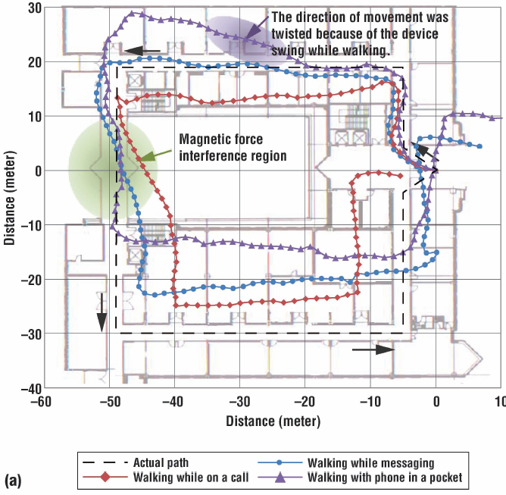
Experiments
Depending on the user’s motion, we increase the error bound to the step length (minimum) and double the step length (maximum), which are loosely estimated to include the actual location within the error bound.
Fig 9(a)

Slide 17
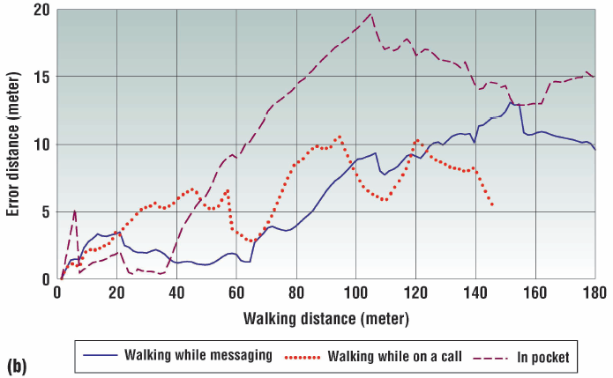
Experiments
Fig 9(b)

Slide 18
Experiments
Figure 10 shows the aggregated user context of three students collected for a week on a university campus.
      Among 54 POIs, 46 points are generated indoors where the GPS signal is unavailable. Thus, the experiment participants manually obtained the ground truth through Google Maps.
      Of the indoor generated POIs, 91 percent of the points indicate the actual position within the estimated error bound, and the average error is 25.6 meters.
      The aggregation process helped to reduce the POIs from 54 to 18. Still, 83 percent of the points contain their reference locations, and the average error is reduced to 17.7 meters because the nodes with smaller error bounds have been chosen as the superseding one.

Slide 19
Experiments
One drawback of our method is that the system might generate inaccurate locations if the GPS signal accuracy is poor because the system establishes an initial location through the GPS signal.
Energy efficiency: The collected user traces show that the average amount of time in the moving state is less than three hours a day. This indicates that the average movement ratio is less than 20 percent in one day.

Slide 20
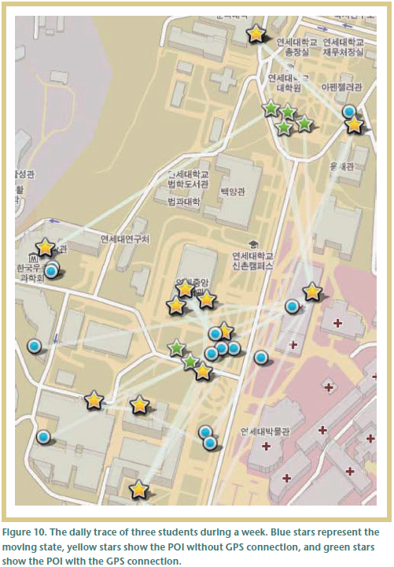
Experiments
Fig 10

